Slide 1
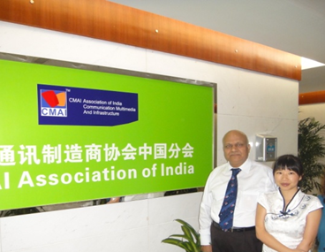
Past and Present Supporters
Department of MSME
Govt . Of India.
CMAI ASSOCIATION OF INDIA
Department of MNRE
Govt . Of India.
Department of Law
Govt . Of India.
Department of DOT
Govt . Of India.

Slide 2
Empowering yourself through education and knowledge in post Covid era
Keynote Presentation
By
Prof NK Goyal, President CMAI
Chairman Emeritus, TEMA. Vice Chairman ITU APT
Chairman, ITPS Dubai
Member, Governing Board Telecom Equipment and Services
Export Promotion Council (Govt. of India)
At
“Transforming Education through Global Collaboration: The Roadmap”
Sinhgad Technical Education Society’s inhgad Institute of Management (SIOM), Pune(India)
15th July, 2020 www.cmai.asia

Slide 3
Compliments
Compliments for wonderful program to:
Prof MN Navale, Founder President, Singhad Technical Education Society
Dr Mrs Sunanda M Navale, Founder Secretary, Singhad Technical Education Society, Pune
Dr Daniel Penkar, Director, SIOM
Dr. Chandrani Singh, Director, Sinhgad Management Institutes

Slide 4
FIVE TRAITS IN TODAY’s PRESENTATION
Stray thoughts on Empowering yourself through education and knowledge
About CMAI
Technologies
Academic Excellence
Personal Excellence
I BELIEVE YOU DO NOT NEED ANY PPT. Singhad has taught you all that is needed
I encourage delegates to go on asking questions in chat/Q&A
I intend to finish presentation in 15 minutes leaving 30 minutes for Q&A

Slide 5
COVID 19 ERA
Covid changed world over the way human used to live, has attacked on his fundamental knowledge and belief.
Economy, Jobs drastically affected.
Globalization is shame- in a second countries exports imports of man and material banned- need for domestic resources
Knowledge we had became irrelevant for momentary time
Education world over stopped initially, then focus on virtual
Human realized several unnecessary, unwanted things we were engaged in eating, meeting habits
NEED TO SEE AND THINK NEW WAY

Slide 6
MY PERSONAL VIEW
Can I say WORLD IS A CONFUSED PLACE TODAY
Systems, definitions we are made to follow now were created 250 years before.
Economy, Education, Love, Friendship, Teacher, Student, Bank, Democracy, Politics, Society, Univ.. ..are not same
Aspirations we have, times we are living, the way we live, the way we do things, Needs we have implicit and explicit……..all are changing.
Making information available and Communication are two different things
Time to move on. Do not cling to things which should work, but do not

Slide 7
ABOUT CMAI

Slide 8
About CMAI
CMAI is an ICT largest, apex business and trade promotion organization, with 48,500 members and 74 MOU partners across the world with branch offices in China, Japan, Korea, Singapore, Taiwan, Bangkok, USA, UK and Malaysia.
CMAI is involved in policy formulations with Government and other stake holders for Technology Innovations, Indigenous Manufacturing
CMAI is developing scientific knowledge and practical means for protecting human ecology and environment from the harmful effects of environmental hazards like e waste, radiation etc.
CMAI assists manufacturers to maximize competitiveness in the domestic and international markets.
Only association with linkages from industry and about 1,00,000 Colleges, Schools, Universities.

Slide 9
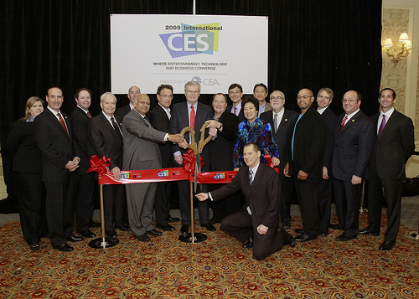
CES, 2009 being inaugurated and ribbon cutting at Las Vegas on 8th January, 2009 by NK Goyal with Sir Howard Stringer, Chairman & CEO of Sony Corporation, Mr. Tom Hanks, the American movie star, Mr.Gary Yacoubian, Chairman CEA & President of Myer-Emco AudioVideo, Mr. Gary Saprio, Vice President of CEA, Ms. Qu., Presixdent, CECC China, Mr. Patrick Lavelle, President and CEO of Audiovox, Mr. Peter Lesser, President and CEO of X-10 (USA) Inc, Mr. Loyd Ivey, Chairman and CEO of MiTek Electronics and Communications, Mr. Jay McLellan, President and CEO of Home Automation, Inc. (HAI), Mr. Mike Mohr, President of Celluphone, Mr.Grant Russell, President of Kleen Concepts

Slide 10
Goals
Promote Trade Relations with
Government, Industry, Society, Consumer
in
Education, Vocational/Skill Development, Academia Industry Interface, Univ. Exchange Programs, Research Centers
Telecom, ICT, Infrastructure, Renewable Energy, Green Manufacturing,
CYBER SECURITY

Slide 11
CMAI National Technical Education Empowerment Committee
AICTE Chairman, Vice Chairman and Member Secretary, Director co opted as nominated members on the Committee.
to act as an facilitator and help in dissemination of various schemes initiatives of AICTE among Educational Institutes, State Governments, Industries and other stakeholders.
to give guidance to CMAI for making future policies and programs for development of Education, Skill/Vocational Development, Entrepreneurship, Cyber Security, Physically Disable Empowerment, Tribal Development, Faculty Development Program etc.

Slide 12
nkgoyals@yahoo.co.in,
0 98 111 29879
CMAI IN EDUCATION SECTOR

Slide 13
CMAI National Education Awards USP
USP of CMAI Education Events & Summits is that it been organized with Support of State Technical Universities/State Universities Pan India covering 25 States and 7 International Countries in an year with promoting Government’s Mandate.
CMAI is known for research centers in Universities with Industry participation, giving assignments on behalf of industry/Government/MNCs/Foreign technology providers for research in the field of social sciences/technology/social media/customer behavior/ applications etc. for mobile/ technology, vocational/skill courses through NSDC/AICTE, Cyber Security training/workshops, Industry academia interface, internships, exchange of faculty and students with foreign universities, guest lecturers, Tech Fests etc. CMAI is also known for training and formation of Cyber Security-Ethical Hacking and safe web development.

Slide 14
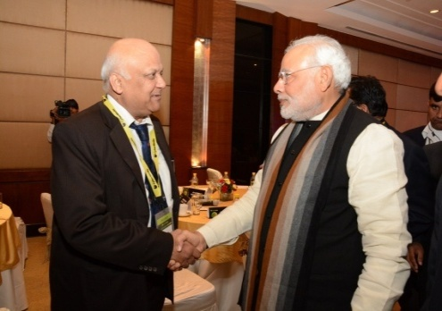
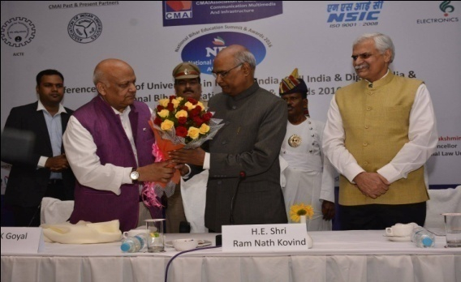
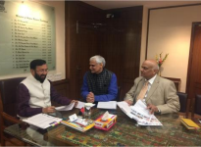
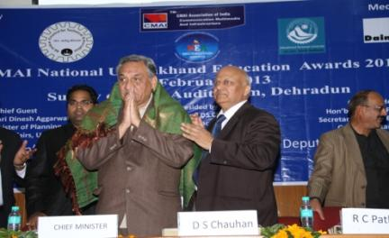
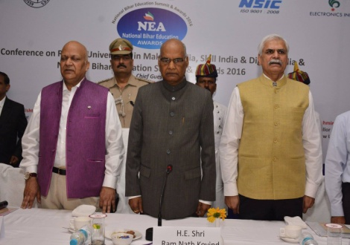
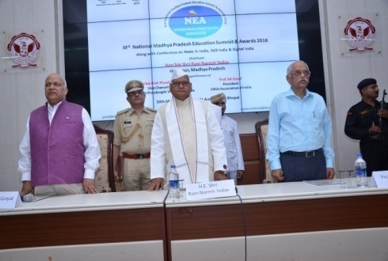
nkgoyals@yahoo.co.in, 0 98 111 29879
CMAI Education Event Snapshots
Hon’ble Mr. Narendra Modi, PM of India
with Prof. NK Goyal, President CMAI
Hon’ble Sh. Ram Nath Kovind ji,
inaugurating summit in Bihar
Hon’ble Mr. Prakash Javedkar, Minister of HRD
with Prof. NK Goyal along with other delegates
Shri NK Goyal, President CMAI Felicitating the then
Shri Vijay Bahuguna Chief Minister Uttarakhand
Hon’ble Shri Ram Nath Kovind,
The then Governor Bihar with Other Dignitaries
on Dias In Bihar Education Summit
Hon’ble Shri Ram Naresh Yadav,
Governor MP with Other Dignitaries on Dias
In Madhya Pradesh Education Summit

Slide 15
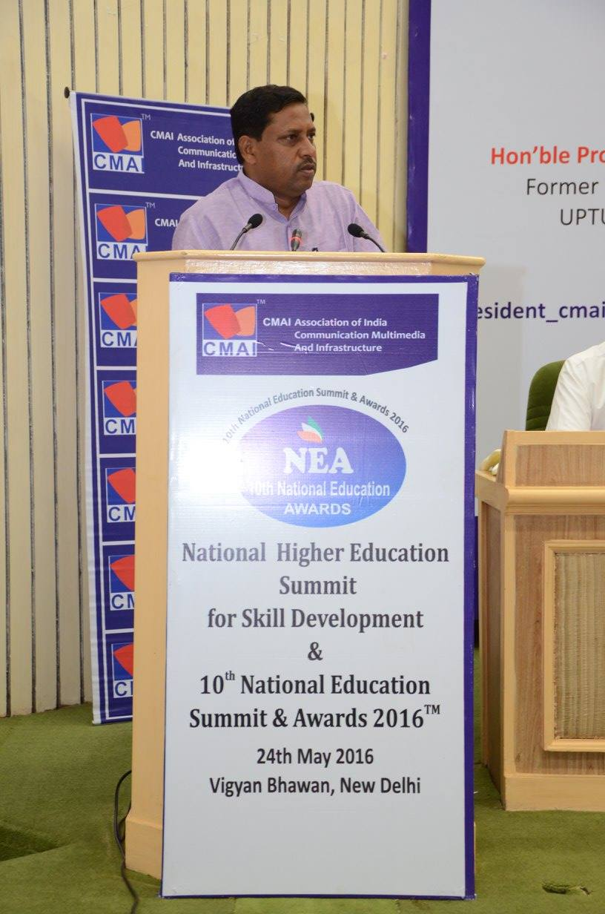
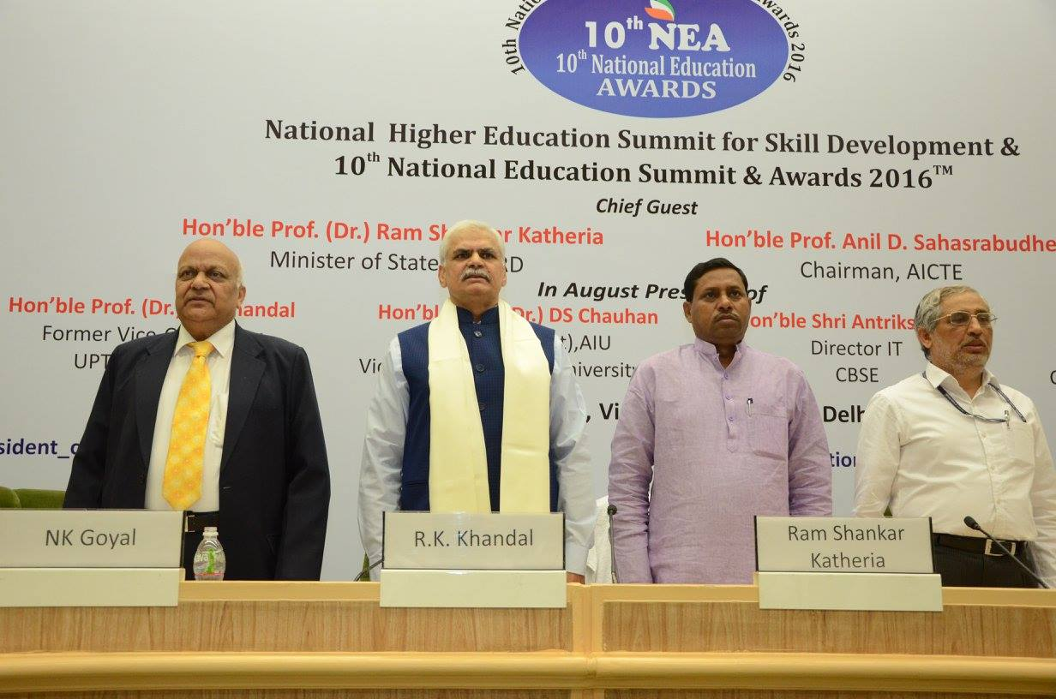
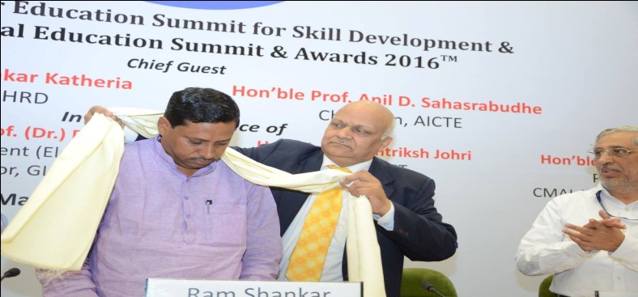
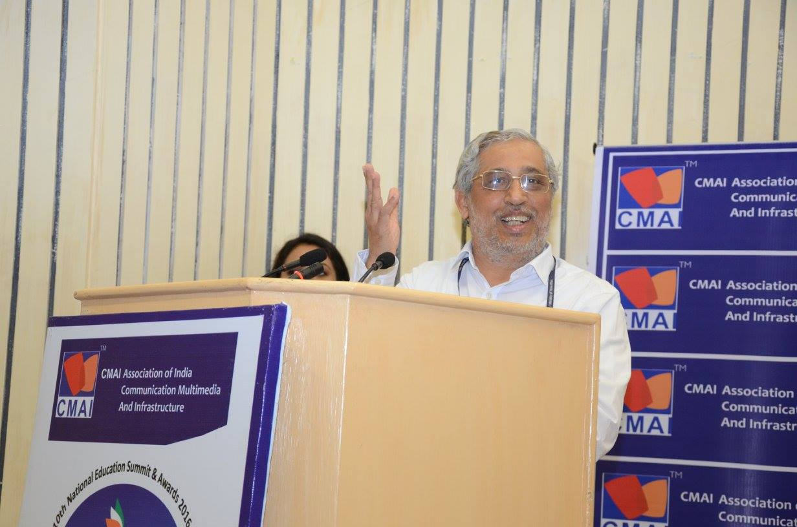
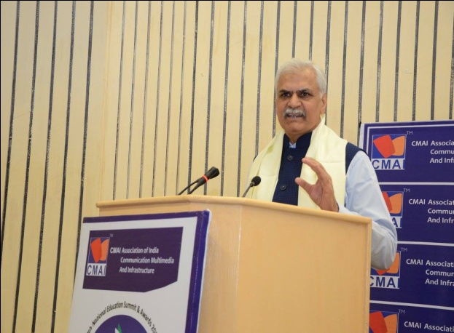
Glimpses of past
National Education Awards
held Pan India
nkgoyals@yahoo.co.in, 0 98 111 29879
Hon’ble Prof. (Dr.) Ram Shankar Katheria, the then Minister of State for HRD.
Dr. RK Khandal
Former Vice Chancellor, Uttar Pradesh Technical University.
Hon’ble Prof. Anil D. Sahasrabudhe, Chairman, AICTE

Slide 16
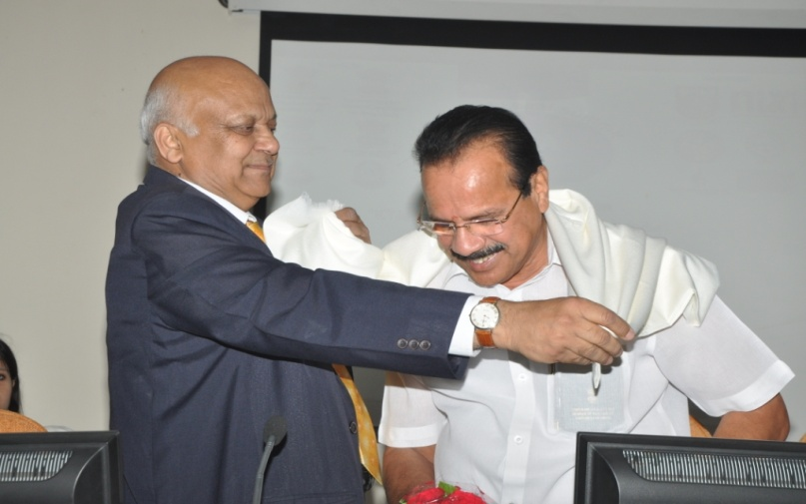
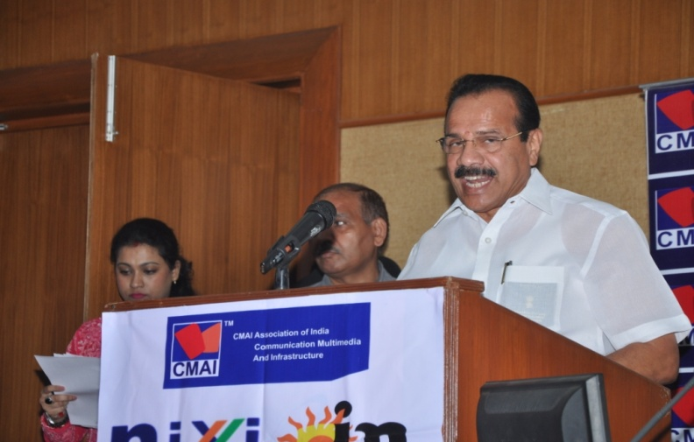
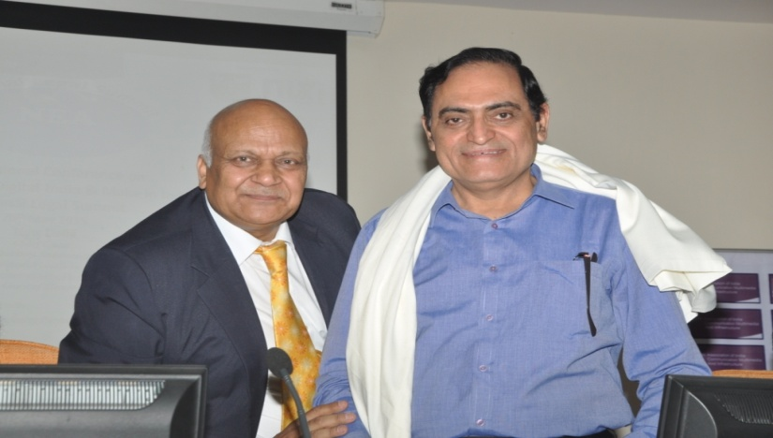
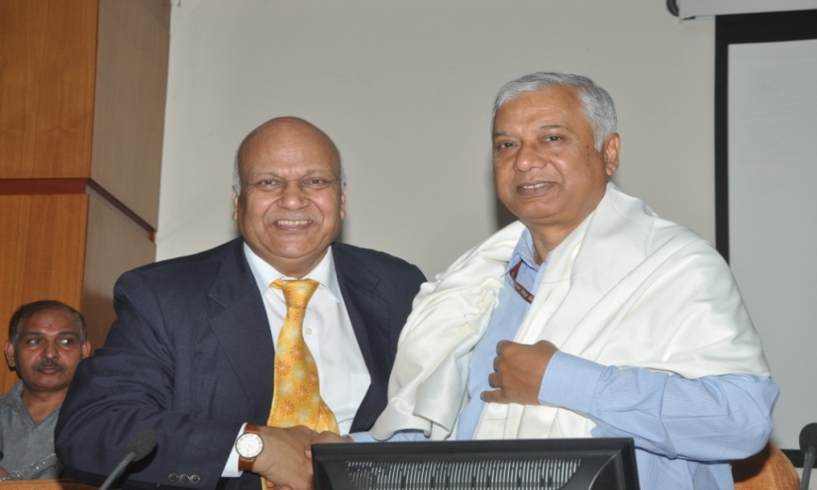
“Conference on ICT in Law
for Digital India & Make in India”
nkgoyals@yahoo.co.in,
0 98 111 29879
The Summit has celebrated & recognized the finest work across the Legal Educational Institutes, Legal professionals, Teachers, Researcher, Hindi/English/Regional Language Law Books Publishers, Subject specific experts in Law, lawyers, judges, clients and in-house teams, Cyber Security Experts, NGO’s, Public Interest Litigants, Policy Makers, Legislative Drafting, Arbitration and other Stakeholders.
Hon’ble Shri D.V Sadananda Gowda, Minister of Law and Justice
Government of India being felicitated by Prof. NK Goyal, President
Hon’ble Shri D.V Sadananda Gowda, Minister of Law and Justice
Government of India addressing the audience
Hon’ble Shri P.K Malhotra, Secretary Law Government of India
being felicitated by Prof. NK Goyal, President
Hon’ble Shri Rakesh Garg, Secretary DOT, Government of India
being felicitated by Prof. NK Goyal, President

Slide 17
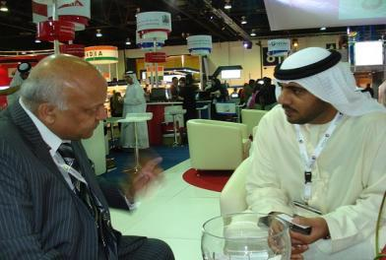
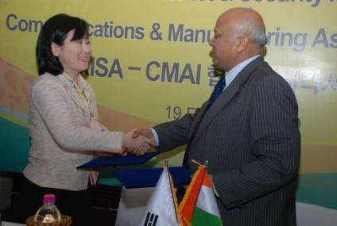
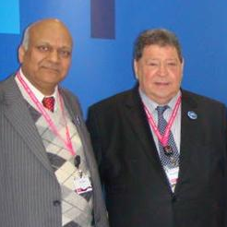
CMAI Engagements with
VVIP’s Across Globe
nkgoyals@yahoo.co.in,
0 98 111 29879
With President of Republic of Rwanda
UAE : Minister of Information Technology
With IT Minister of Israel
With Spokesperson of President of Korea

Slide 18
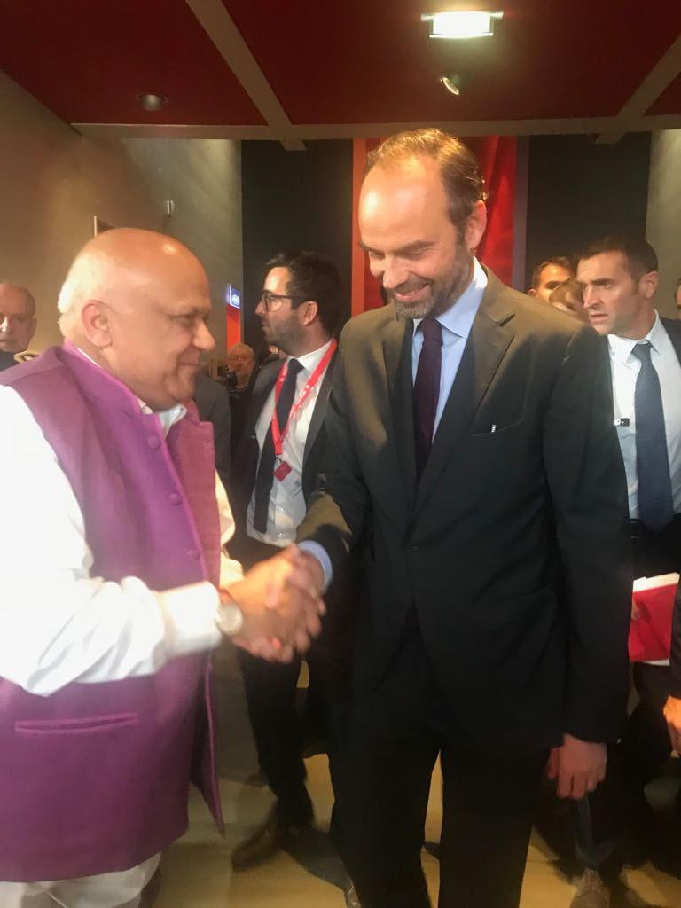
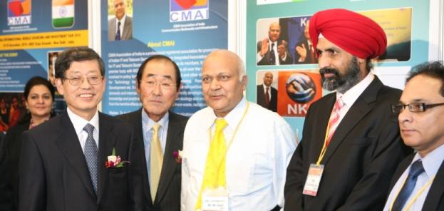
nkgoyals@yahoo.co.in, 0 98 111 29879
Prof. Goyal with Hon’ble Prime Minister of South Korea, France, Taiwan

Slide 19
nkgoyals@yahoo.co.in, 0 98 111 29879

Slide 20
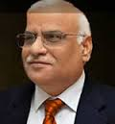
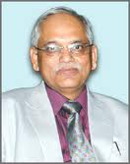
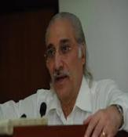
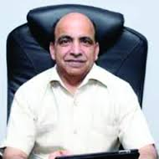
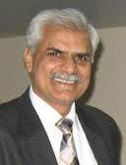
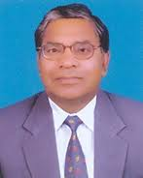
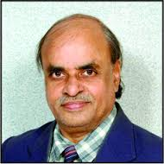
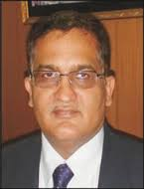
nkgoyals@yahoo.co.in, 0 98 111 29879
Vice Chancellors with whom CMAI is associated
Prof. DS Chauhan
Vice Chancellor
Uttarakhand Technical University, UK
Dr. Piyush Trivedi
Vice Chancellor
Rajiv Gandhi Proudyogiki Vishwavidyalaya, MP
Prof. SK Kak
Vice Chancellor
Mahamaya Technical University, UP
Dr. Rajneesh Arora
Vice Chancellor
Punjab Technical University Punjab
Dr. RK Khandal
Vice Chancellor
Uttar Pradesh Technical University, UP
Dr. ML Ranga
Vice Chancellor
Guru Jambheshwar University of Sci & Tech., Hisar
Prof. HS Chahal
Vice Chancellor
Maharishi Dayanand University
Prof. K Lal Kishore
Vice Chancellor
JNTU, Anantapur
Shri. Sudhir Kumar (IAS)
Vice Chairman
State Board of Technical Education,
Prof. Avinash C pandey
Vice Chancellor
Bundelkhand University, Jhansi
And More….

Slide 21
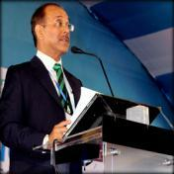
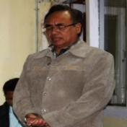
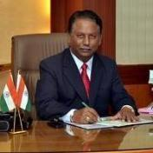
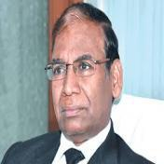
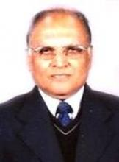
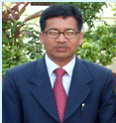
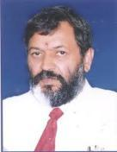
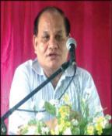
nkgoyals@yahoo.co.in, 0 98 111 29879
Vice Chancellors with whom CMAI is associated
Dr. Mridul Hazarika
Vice Chancellor
Gauhati University
Prof. R.Lalthantluanga
Vice Chancellor
Mizoram University
Dr. H. Maheshappa
Vice Chancellor
VTU
Dr. Akshai Aggarwal, Vice Chancellor, Gujarat Technological University
Dr. LN Bhagat
Vice Chancellor
Ranchi University
Dr. Akhilesh Kumar Pandey
Chairman
Madhya Pradesh Private University Regulatory Commission
Prof. P.P Mathur
Vice Chancellor
KIIT University
Dr. ADN Bajpai, Vice Chancellor, HP University
Prof. BK Konwar,
Vice Chancellor,
Nagaland University

Slide 22
nkgoyals@yahoo.co.in, 0 98 111 29879
CMAI Talks on:
• Excellence in life
• Sound and Yogic Sleep
• Willpower is the key to success
• Self-motivation is a key life skill
• Self-confidence enhancing
• Time management
• Turning Problems into Opportunities
• Conflict Management
• Communication Skills
• Stress Management
• Healthy and Vibrant Life Style
• Human Body Energy managemen

Slide 23
nkgoyals@yahoo.co.in, 0 98 111 29879
CMAI organizes guest lectures and
presentations on following topics among others:
1. ICT, Mobile, Telecom
2. Digital India, Make in India, Skill India, Start Up India
3. Cyber security
4. International Trade and Business
5. National Vocational/Skill Development Framework NSEQF/NVEQF
6. Education Policy
7. Motivational and Inspirational Address
8. Excellence in Life
9. Youth as Leaders
10. Empowerment of Youth, women
11. Spiritual, Yoga and Mind Development, Stress management

Slide 24
TECHNOLOGIES & EDUCATION

Slide 25
IN THE 80’S THE PERCEPTION OF AN IDEAL CAREER WAS A GOVT JOB
Notes:
ok

Slide 26
IN THE 90’S THE PERCEPTION OF AN IDEAL CAREER BECAME A JOB
IN TECHNOPARK
Notes:
ok

Slide 27
TODAY THE PERCEPTION NEED TO BE SHIFTED FROM
JOB SEEKERS TO JOB CREATORS
Notes:
ok

Slide 28
Technology & Education
Massive Role
Changing rapidly with new jargons AI, Block Chain, Big Data, 5G, 6 G and so on
Innovations beyond human imagination
Unpredictable
Education leads to Technology earlier
Now Technology leads to Education
Future Human imaginative needs will drive technology and education

Slide 29
FIVE IMPORTANT THINGS TO HAPPEN
Social Media/Networking
Beyond borders, class, rich/poor-equal opportunity to all
Changing world, Cultures, way of living
Egyptian Revolution, NDA Elections
Virtual Human
Mobility, Sensors and Computing
Internet of things, M2M
Cloud
E-Mobile Commerce v/s Brick and Mortor
New Models of Business: Big Data, Analytics, Websites, Missed Call, Call Based Marketing,
Delivery Platforms: Drones, unmanned Cars, Production Technologies-Manufacturing Industries
AND YOU NEED SKILLS FOR ALL THESE

Slide 30
MESSAGE FOR TECHNOLOGY

Slide 31
Way Forward
Focused on Goals
Study Study Study & Research
Keep you update
New learning's needed – technologies and also Knowing how to create impact virtually in least available time
Become Entrepreneur, Innovator

Slide 32
ACADEMIC EXCELLNCE

Slide 33
HOW TO ACHIEVE ACADEMIC EXCELLENCE
Put God first - Do not allow your studies to compete with God’s time
Prioritize
Set a target-it ignite your passion
Be disciplined - Self discipline is a conscious control over your lifestyle
Stay focused- Know what you want and go for it with all determination, enthusiasm and optimism.
Manage your time- Time is a free but non-renewable resource, so spend each moment wisely.
Keep the right Company- Quickly identify friends not relevant to your goals and dissociate yourself before you become entangled.
Don’t copy others- Never follow friends when it is very inconvenient for you, you might just be the greatest loser, so be wise.
Prepare adequately- Knowing fully that you have to pass it to be promoted to the next level, why won’t you give it your best shot.

Slide 34
What to learn?
Things which have lost their significance
Processes which have lost their credibility
Traditions which are time consuming and mostly based on orthodox
Technology which is no longer necessary, viable, needed or have became obsolete
Truths which has become propagandas
Knowledge which are not cost effective
Relationships which have become painful, time consuming or unprogressive

Slide 35
PERSONAL EXCELLNCE

Slide 36
BE A GOOD HUMAN
Passionate towards living being….they all in this world for a cause, let them do.
Love your parents. They need to know that you care and are happy. Don't ignore them later in your life.
Family attitude…pressure cooker in home…you cannot do without them…find out space, time ..smallest opportunity to share, start from smallest things…flower, bangle, bindi, cosmetics, vegetables, fruits and so on
Keep Good behavior intact…Scorpio storey
Smile…biggest answer to several problems… nature co exists

Slide 37
What are some things not to do in my life?
Don’t ignore personal, mental, physical health, hygiene & well being.
Don't live with people who consistently make you feel inferior in any way.
Never take important decisions based on people's advice. Nobody but you know what suits you best and nobody but YOU have to face the consequences, good or bad.
Don't spend ANY time getting envious of others. There'll be tons of situations in your life where someone else will be climbing the ladder faster
Don’t complain in life. Complaining only tends to bring a cloud of negativity to your mind which is always in search for excuses.
Don’t expect too much in life - People, situations and nature are few of the things beyond our control.

Slide 38
Excellence is a Habit
Excellence is not a Skill. It is an attitude
Excellence is doing common things in uncommon way & is the Result of
Caring more than others think is Wise,
Risking more than others think is Safe,
Dreaming more than others think is Practical
Expecting more than others think is Possible
Do your best and a little better than you can think

Slide 39
CMAI YRACLUB MEMBERSHIP
As part of youth empowerment, CMAI has initiated a YRA CLUB.
Complimentary Membership for www.yraclub.org
http://www.cmai.asia/Youth-Student.php
Regular updates on job alerts, personality development skills, technology updates, cyber security alerts.
Photograph of Education Events.

Slide 40
THANKS
www.cmai.asia
nkgoyals@yahoo.co.in
+91 98 111 29879
http://in.linkedin.com/in/nkgoyals,
http://www.facebook.com/nkgoyalcmai

